Slide 1
Introduction to the Linux Operating System

Slide 2
What is an Operating System?
Every time you switch on your computer, you see a screen where you can perform different activities like write, browse the internet or watch a video.
What is it that makes the computer hardware work like that?
How does the processor on your computer know that you are asking it to run a mp3 file?

Slide 3
it is the operating system or the kernel which does this work.
A kernel is the program at the heart of any operating system that takes care of fundamental stuff, like letting hardware communicate with software

Slide 4
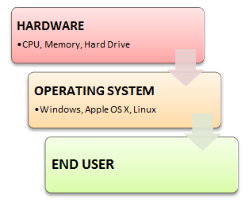

Slide 5
What is Linux? Who created Linux?
Linux is an operating system or a kernel which germinated as an idea in the mind of Linus Torvalds when he was a computer science student.
He used to work on the UNIX OS , and thought that it needed improvements.
when his suggestions were rejected by the designers of UNIX, he thought of launching an OS which will be receptive to changes, modifications suggested by its users.

Slide 6
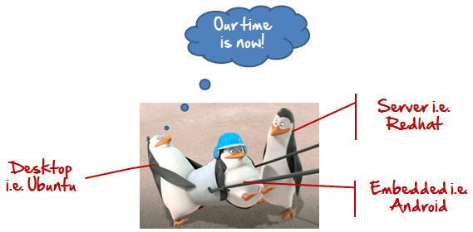
Linux gets its due attention

Slide 7
The main advantage of Linux was that programmers were able to use the Linux Kernel in order to design their own custom operating systems.
Now, Linux is one of most popular and widely used Kernel, and it is the backbone of popular operating systems like Debian, Ubuntu, and Fedora.
Nevertheless, the list does not end here as there are thousands of OS's based on Linux which offer a variety of functions to the users.

Slide 8
The benefits of using Linux
It offers a free operating system. You do not have to sell hundreds of dollars to get the OS like Windows!
Being open-source, anyone with programming knowledge can modify it.
The Linux operating systems now offer millions of programs/applications to choose from, most of them free!
Once you have Linux installed you no longer need an antivirus! Linux is a highly secure system.
Linux is the OS of choice for Server environments due to its stability and reliability (Mega-companies like Amazon, Facebook ,and Google use Linux for their Servers).
A Linux based server could run non-stop without a reboot for years on end.

Slide 9

Is it for me?
Users, who are new to Linux, falsely considering it as a difficult and technical OS to operate.
In the last few years Linux operating systems have become a lot more user-friendly

Slide 10
I am asked to Learn Unix? Then why Linux?
UNIX is called the mother of operating systems which laid out the foundation to Linux.
Unix is designed mainly for mainframes and is in enterprises and universities .
While Linux is fast becoming a household name for computer users , developers and server environment.
You may have to pay for a Unix kernel while in Linux it is free.

Slide 11
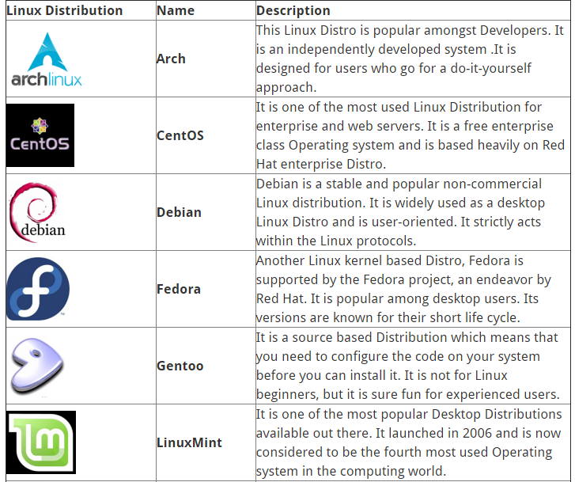
Linux Distribution

Slide 12
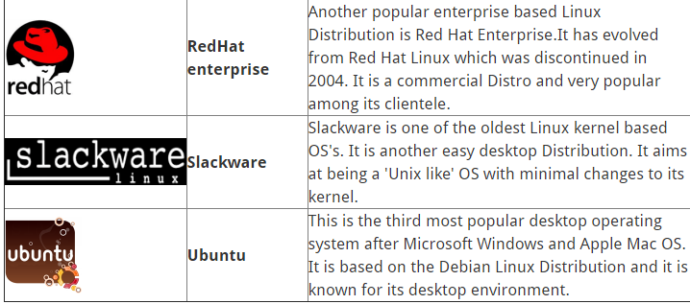

Slide 13
Installing Linux

Slide 14
Linux Vs Windows
In Microsoft Windows, files are stored in folders under different data drives like C: D: E:
But, in Linux, files are ordered in a tree structure starting with the root directory.
This root directory can be considered as the start of the file system and it further branches out various other subdirectories. The root is denoted with a forward slash '/'.

Slide 15
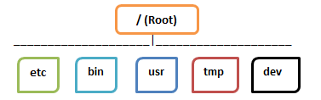

Slide 16
Types of Files
In Linux and UNIX, everything is a file. Directories are files, files are files, and devices like Printer, mouse, keyboard etc are files.
3 categories are:
* General Files
* Directory Files
* Device Files

Slide 17
General Files also called as Ordinary files. They can contain image, video, program or simply text.
Directory files: These files are a warehouse for other file types. You can have a directory file within a directory (sub-directory).You can take them as 'Folders' found in Windows operating system.

Slide 18
Device files: In MS Windows, devices like Printers, CD-ROM and hard drives are represented as drive letters like G: H:.
In Linux, there are represented as files.
For example, if the first SATA hard drive had three primary partitions, they would be named and numbered as /dev/sda1, /dev/sda2 and /dev/sda3.

Slide 19
Users in Linux
There are 3 types of users in Linux
1.Regular
2.Administrative(root)

Slide 20
Regular User
A regular user account is created for you when you install Ubuntu on your system.
All your files and folders are stored in /home/ which is your home directory.
As a regular user, you do not have access to directories of other users.

Slide 21
Root User
Other than your regular account another user account called root is created at the time of installation.
The root account is a super user who can access restricted files, install software and has administrative privileges.
Whenever you want to install software, make changes to system files or perform any administrative task on Linux; you need to log in as a root user.

Slide 22
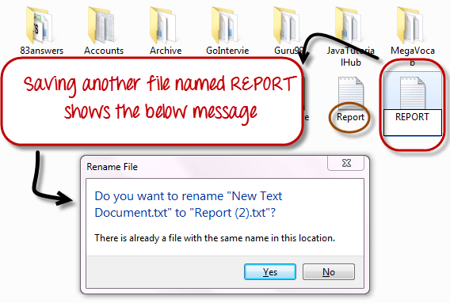
File Name Convention
In Windows, you cannot have 2 files with the same name in the same folder. See below -

Slide 23
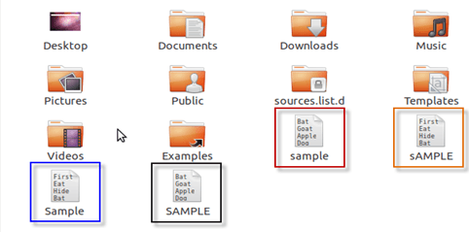
While in Linux, you can have 2 files with the same name in the same directory, provided they use different cases.

Slide 24
The HOME Directory
For every user in Linux, a directory is created as /home/
Consider, a regular user account "Tom". He can store his personal files and directories in the directory "/home/tom".

Slide 25
Other Directories
In Windows, System and Program files are usually saved in C: drive.
But, in Linux you would find the system and program files in different directories.
For example, the boot files are stored in the /boot directory and program and software files can be found under /bin , device files in /dev.

Slide 26
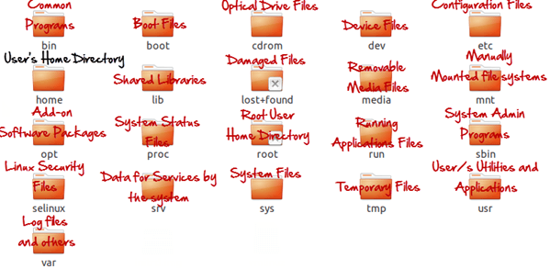

Slide 27
Terminal V/s File Manager & The CD command
To manage your files , you can either use
Terminal (Command Line Interface - CLI)
File manager (Graphical User Interface -GUI)

Slide 28
Why learn Command Line Interface ?
Comparatively , Commands offer more options & are flexible.
Some configurations in GUI are up to 5 screens deep while in a CLI it's just a single command.
CLI load fast and do not consume RAM compared to GUI. In crunch scenarios this matters.

Slide 29
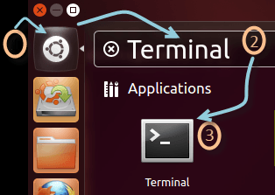
Launching the CLI on Ubuntu
1) Go to the Dash and type terminal
2) Or you can press CTRL + Alt + T to launch the Terminal.

Slide 30
Listing files (ls)
'ls-R' to shows all the files not only in directories but also subdirectories.
ls - a to show the hidden files.
'ls -al' gives detailed information of the files.
.
1st Column | File type and access permissions
2nd Column | # of HardLinks to the File
3rd Column | Owner and the creator of the file
4th Column | Group of the owner
5th Column | File size in Bytes
6th Column | Date and Time
7th Column | Directory or File name

Slide 31
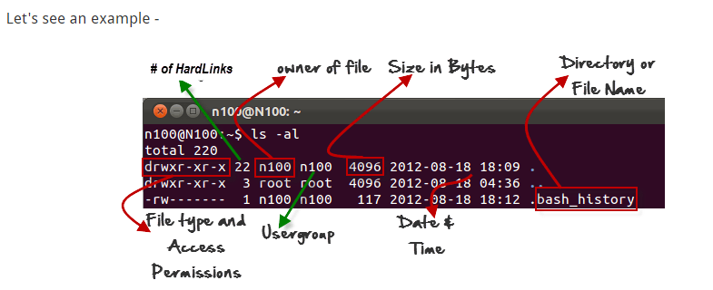

Slide 32
Path Navigation
Cd -->home directory
Pwd --> Present working directory
Cd / --> Root directory
Cd Desktop --> Move to the subdirectory
Cd .. --> Move to the parent directory

Slide 33
Create file
touch filename -->Create a new empty file
> filename -->Create a new empty file
Cat > filename -->It will erase the existing content and add new input ,use[cntrl]+[d] to save file.
Cat filename --> view file contents
echo “helloworld” >> filename--> append text on new file.

Slide 34
Creating & Viewing Files
The 'cat' command is used to display text files.
To create a new file, use the command
cat > filename
Add content
Press 'ctrl + d' to return to command prompt.
To view a file, use the command – cat
The syntax to combine 2 files is –
cat file1 file2 > newfilename

Slide 35
Create directory
mkdir foldername --> Create a new directory
sudo mkdir foldername --> Create a directory with superuser rights.

Slide 36
Rename a directory
mv oldname newname -->rename directory.

Slide 37
Edit or update file
nano filename --> Open file with nano editor.
gedit filename --> Open GUI editor
vim filename --> Open file with vim editor

Slide 38
Delete files and folders
sudo rm filename --> Remove the file
Sudo rm foldername -R --> Remove folders
or
Sudo rm -r filename --> Remove directory
Sudo rm -rf filename --> Remove recursively and forcefully.

Slide 39
Rename &Move
Sudo mv file1 file2 --> rename file1 with file2

Slide 40
Copy command
sudo cp filename file.bak

Slide 41
pwd -> print work (current) directory
cd <directory> -> change directory to...
cd .. -> change to parent directory
cd - -> change to previous directory
cd -> change to home directory
mkdir <directory> -> make directory
touch -> make a 0 byte file if it does not exist
cp -> copy (for files)
cp -a -> copy (for directories)
rmdir -> remove empty directory
rm -> remove (for files)
rm -f -> remove forcefully ( " " )
rm -r -> remove recursively (for directories)

Slide 42
mv -> move OR rename
exit -> log out from the system
clear -> clear the screen
whoami -> display username of current user
who -> display users logged in the system with their respective terminals and time since logged in
who am i -> display current user, terminal and uptime

Slide 43
init 6 -> reboot the system
reboot
shutdown -tx -r now
where x is in seconds
shutdown +x
where x is in minutes

Slide 44
User,group & Permissions
Managing users in Linux
sudo adduser username --> add user
sudo userdel username --> delete user
All the configuration files are stored s text file
/etc/passwd store all the information of user account.
Eg: sudo vim /etc/passwd
To change password: sudo passwd username

Slide 45
Managing groups
Groups are created either to provide access or restrict access to several users.
Create group
Sudo groupadd grpname --> create group
Sudo groupdel grpname --> delete group
adding user to group
sudo adduser username groupname
Removing group
sudo deluser username groupname
Check sudo vim /etc/group

Slide 46
Permission
7 7 7 --> highest permission
7 --> owner permission
7 -->Group permission
7 -->Others
Rwx -->read,write,execute
4-->read,2-->write,1-->execute
Change permission:
Sudo chmod 777 filename -R

Slide 47
ownership
It changes the ownership of the file
Sudo chown -R username filename
Sudo chgrp -R grpname file/foldername
-R is given if it is a directory/folder.

Slide 48
Redirection
By using some special notation we can redirect the output of many commands to files, devices, and even to the input of other commands.

Slide 49
Standard Output
Most command line programs that display their results do so by sending their results to a facility called standard output. By default, standard output directs its contents to the display. To redirect standard output to a file, the ">" character is used.
Eg: ls > file_list.txt
If you want the new results to be appended to the file instead, use ">>" like this:
Eg: ls >> file_list.txt

Slide 50
Standard Input
By default, standard input gets its contents from the keyboard, but like standard output, it can be redirected. To redirect standard input from a file instead of the keyboard, the "<" character is used like this:
Eg: sort < file_list.txt
The results are output on the display since the standard output is not redirected in this example. We could redirect standard output to another file like this:
Eg: sort < file_list.txt > sorted_file_list.txt

Slide 51
Pipes
We can connect multiple commands together with what are called pipes. With pipes, the standard output of one command is fed into the standard input of another.
Eg: ls -l | less
ls -l | more
The output of the ls command is fed into less. By using this "| less" trick, you can make any command have scrolling output.

Slide 52
Filters
One class of programs you can use with pipes is called filters. Filters take standard input and perform an operation upon it and send the results to standard output.
Sort : Sorts standard input then outputs the sorted result on standard output.
Uniq : Given a sorted stream of data from standard input, it removes duplicate lines of data (i.e., it makes sure that every line is unique).
Grep : Examines each line of data it receives from standard input and outputs every line that contains a specified pattern of characters.
Head:Outputs the first few lines of its input. Useful for getting the header of a file.

Slide 53
Tail: Outputs the last few lines of its input. Useful for things like getting the most recent entries from a log file.
Cut : To cut certain information from the file.
Paste: It is used to merge multiple files.

Slide 54
Links-Hardlink and Softlink
About Inode
The file system contains 'blocks' which holds data called inodes.
An inode represent a single file in a file system.
Typical information described including
Mode-Permissions and file descriptor
Owner information
Size
Timestamp
Datablocks (Pointers to the actual data)

Slide 55
Hard vs soft Links
Softlinks are similar to the shortcuts in windows.
One file can have many shortcuts pointing to it.
Hardlinks are just diffrent names for the same file.
One file can have many diffrent names.

Slide 56
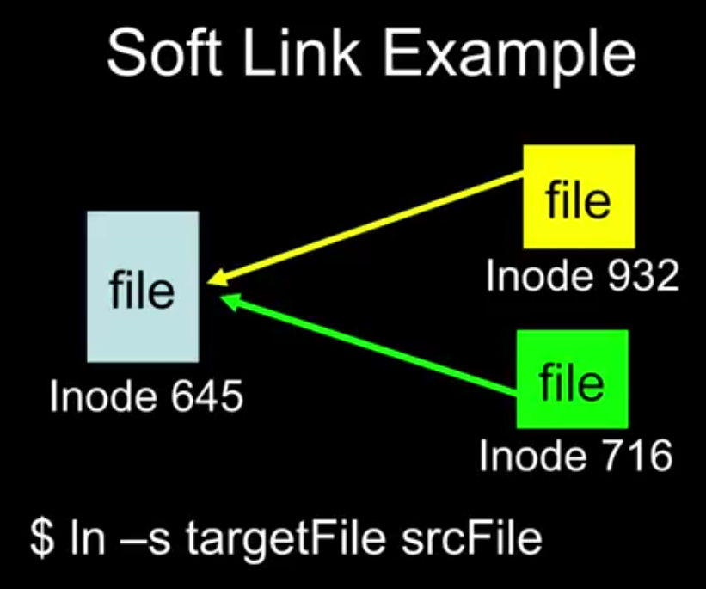
Softlink Example

Slide 57
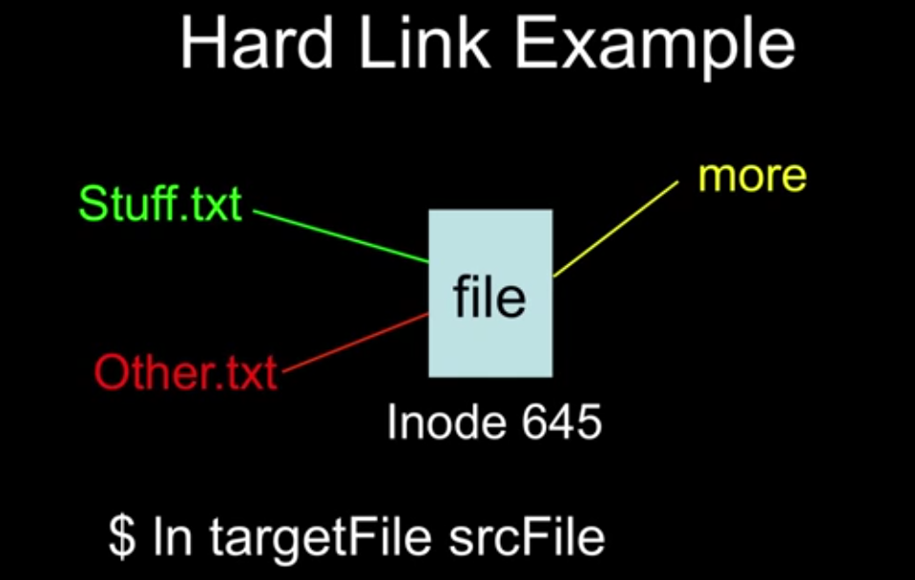
Hardlink Example

Slide 58
Job control in Ubuntu
ps
kill
fg
bg
jobs

Slide 59
Shell Scripting
A shell usually interprets a single line of input, but we can also create a file containing a number of lines of commands to be interpreted
This file is a program known as a shell script
The program can also contain control structures (if-then, loops)
Shell scripts allow a sequence of commands to be executed automatically

Slide 60
Lamp server
Configure a web server and create applications like login forms using PHP.

Slide 61
Install Apache
sudo apt-get install apache2
To make sure everything installed correctly we will now test Apache to ensure it is working properly.
Open up any web browser and then enter the following into the web address: http://localhost/
You should see a folder entitled apache2-default/. Open it and you will see a message saying "It works!" . congrats to you!

Slide 62
Install PHP
sudo apt-get install php5 libapache2-mod-php5
In order for PHP to work and be compatible with Apache we must restart it. Type the following code in Terminal to do this:
sudo /etc/init.d/apache2 restart

Slide 63
Test PHP
sudo gedit /var/www/html/testphp.php
This will open up a file called phptest.php.
Copy/Paste this line into the phptest file:
<?php phpinfo(); ?>
Save and close the file.
Now open your web browser and type the following into the web address:
http://localhost/testphp.php

Slide 64
Install Mysql
sudo apt-get install mysql-server libapache2-mod-auth-mysql php5-mysql
sudo apt-get install mysql-client
sudo apt-get install phpmyadmin
To change password
sudo mysqladmin -u root password 'your_password'

